Slide 1


Capstone Project
Banking
Notes:
Hi everyone,
My name is Shiraj Ahmad,
and I'm a mentor here for data science.
In this session, I'll be explaining Power BI's Capstone Project: Banking
First, congratulations on completing Excel, SQL, and Power BI.
After completing this Capstone Project, you'll be job-ready!
So, let's get started.

Slide 2
Overview
User and Security
Account Management
Transaction and Logs
Customer Information
Employee
Notes:
Overview of Power BI Dashboard for Banking Dataset:
It offers comprehensive insights into various aspects of a banking system, focusing on user and security, account management, transactions and logs, customer information, and employee-related data.
It leverages data from these different tables to provide a holistic view of the banking operations, performance, and customer interactions.
User and Security emphasizes user management, access controls, and security-related data. It includes visualizations on user logins, security answers, and questions. Additionally, it highlights user access patterns and potential security vulnerabilities to ensure the confidentiality and integrity of the banking system.
The Account Management section provides an overview of different types of accounts and their statuses. It includes visualizations on account types, account statuses, and related metrics. This analysis helps bank administrators and managers understand the distribution and performance of various account types.
Transactions and Logs focuses on tracking and analyzing transactions made by customers. It showcases visualizations on transaction logs, failed transaction errors, and overdraft logs. Understanding transaction trends and error patterns allows for identifying potential issues and optimizing the banking process.
Customer Information section offers insights into customer demographics, preferences, and account activities. It includes visualizations on customer details, customer accounts, and saving interest rates. Analyzing customer data helps in tailoring personalized services and marketing strategies.
Employee provides a comprehensive view of employee-related data, such as employee details and roles. It may include visualizations on employee information, job roles, and performance metrics. This analysis aids in workforce management and evaluating employee contributions to the bank's success.
Benefits:
The Power BI Dashboard empowers bank administrators and decision-makers to make data-driven decisions. Insights from the dashboard facilitate optimizing services, improving security measures, and enhancing customer experience.
By monitoring user access and security patterns, the dashboard helps ensure data security and compliance with regulatory requirements.
Analyzing customer information allows for effective segmentation and personalized marketing strategies, leading to improved customer satisfaction and loyalty.
The dashboard's transaction analysis helps in identifying potential issues and streamlining the transaction process, ensuring smoother customer interactions.
Evaluating employee performance aids in recognizing high-performing individuals and supporting targeted training and development initiatives.

Slide 3

Problem Statement
Objective
Analysis Scope
Goal
Insights & Recommendations.
Report & Presentation
Notes:
The objective of this project is to develop a comprehensive Power BI dashboard for a Banking Database, which empowers bank administrators and decision-makers to make data-driven decisions. Insights from the dashboard facilitate optimizing services, improving security measures, and enhancing customer experience.
Analysis Scope: The analysis will focus on extracting valuable insights from the Banking Database to provide meaningful information to stakeholders. The dashboard will cover a wide range of areas, such as customer behavior, transaction trends, employee performance, and account status.
Goal: The main goal of this project is to create an interactive and visually appealing Power BI dashboard that presents crucial information about the bank's operations, customer behavior, and financial performance. The dashboard should enable decision-makers to make informed and data-driven decisions.
Insights & Recommendations: The Power BI dashboard will be designed to provide valuable insights into customer demographics, account types, and transaction patterns. It will identify opportunities for cross-selling and up-selling, enabling the bank to enhance customer satisfaction and increase revenue. Additionally, the dashboard will analyze employee performance and provide recommendations for training and development.
Report & Presentation: The final deliverable will consist of a detailed report describing the data sources, data cleansing and transformation processes, and visualization techniques used in the dashboard. The report will be accompanied by a comprehensive presentation that highlights key findings and insights.

Slide 4


Significance
Valuable insights
Improvement focus
Evaluation of effectiveness
Trend identification
Comprehensive understanding
Notes:
Significance: The Power BI dashboard is significant for the bank as it will help improve decision-making processes, identify potential areas for improvement, and support strategic planning. It will enable the bank to gain a comprehensive understanding of its operations, customer preferences, and overall financial health.
Valuable Insights: The Power BI dashboard will provide valuable insights into customer segments with the highest profitability, allowing the bank to target its marketing efforts more effectively. It will also identify transaction patterns that may indicate fraudulent activities, helping the bank to enhance security measures.
Improvement Focus: The dashboard will focus on identifying areas of improvement, such as reducing failed transactions, optimizing overdraft log management, and improving customer retention strategies.
Evaluation of Effectiveness: The effectiveness of the dashboard will be evaluated based on its ability to present data in an easily understandable format, provide actionable insights, and support data-driven decision-making.
Trend Identification: The dashboard will analyze historical data to identify trends in customer behavior, transaction volumes, and account status changes. This will help the bank predict future trends and adapt its strategies accordingly.
Comprehensive Understanding: By consolidating data from various tables, the Power BI dashboard will provide a comprehensive understanding of the bank's performance, risks, and growth opportunities. It will help stakeholders gain actionable insights and make well-informed decisions.
Overall, the Power BI dashboard for the Banking Database will serve as a powerful tool for the bank, enabling it to stay competitive, enhance customer satisfaction, and achieve its strategic objectives.

Slide 5
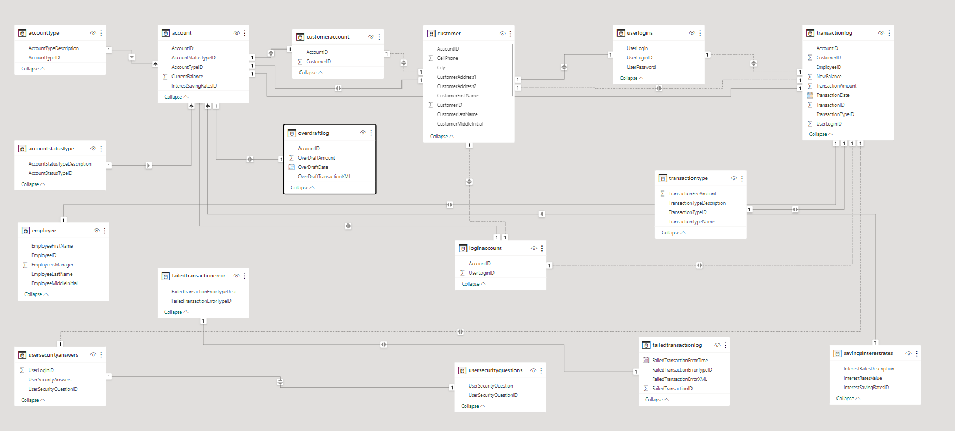
ER Diagram
Notes:
Now that we have comprehended the problem statement and recognized the significance of the project, let's delve into a thorough understanding of the dataset.
An Entity-Relationship (ER) diagram for the Banking Database can visually represent the relationships and interactions between various entities (tables) in the database.
Account: Represents individual accounts in the bank, each identified by a unique account ID. It contains attributes such as account number, balance, and account type.
Account Type: Stores different types of accounts available in the bank, such as savings, checking, etc.
Account Status Type: Represents the status types of the accounts, like active, closed, etc.
Customer: Represents bank customers, each identified by a unique customer ID. It contains attributes like customer name, contact information, etc.
Customer Account: Serves as a junction table between customers and their accounts, indicating which customer owns which account(s).
Employee: Represents bank employees, each identified by a unique employee ID. It contains attributes like employee name, designation, etc.
Failed Transaction Error Type: Stores various types of errors that can occur during a transaction.
Failed Transaction Log: Records failed transactions, associating them with the specific error type.
Login Account: Stores login credentials for bank employees to access the system.
Overdraft Log: Records instances of overdrafts made by customers, including relevant details.
Saving Interest Rates: Holds information about interest rates for savings accounts.
Transaction Log: Records details of all transactions made by customers, such as transaction ID, amount, date, etc.
Transaction Type: Represents different types of transactions, like deposits, withdrawals, transfers, etc.
User Logins: Stores login credentials for bank customers to access their accounts online.
User Security Answers: Contains security questions and their corresponding answers for user authentication.
User Security Questions: Stores a list of security questions for user authentication.
I trust that you now have a clear understanding of the Capstone project requirements.

